Slide 1

Section 1.4 Solving Quadratic Equations
Lecture 2
Completing the Square

Slide 2
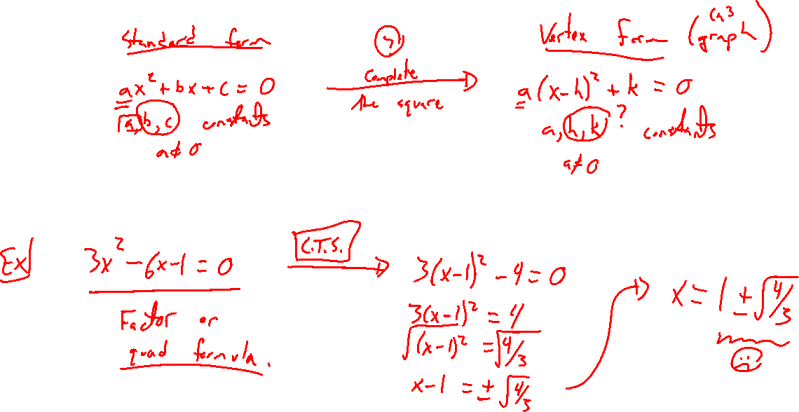
Idea of Completing the Square
Notes:
Rewrite ax^+bx+c=0 (standard form) into a(x-h)^2+k = 0 (vertex form)
Previous example:
3(x-1)^2=4 same as
3x^2-6x-1=0,

Slide 3
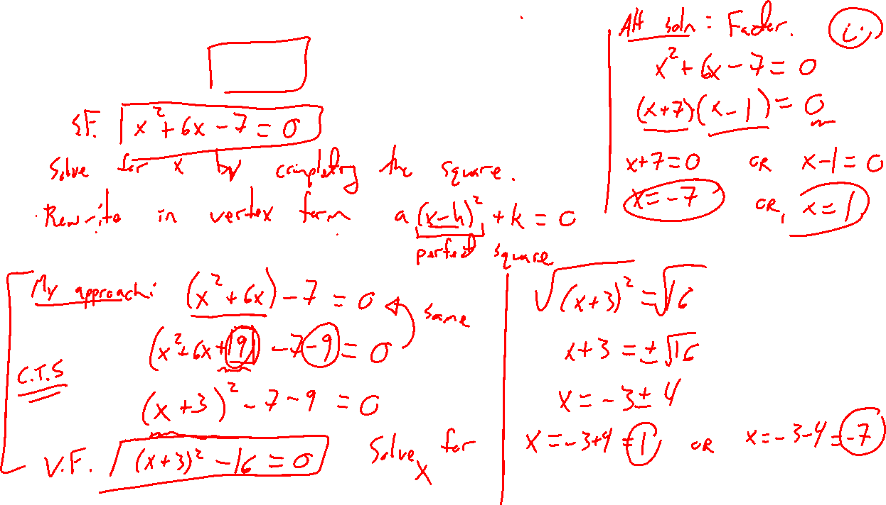
Example: Basic Version
Notes:
X^2+6x-7=0
Note could have factored.

Slide 4
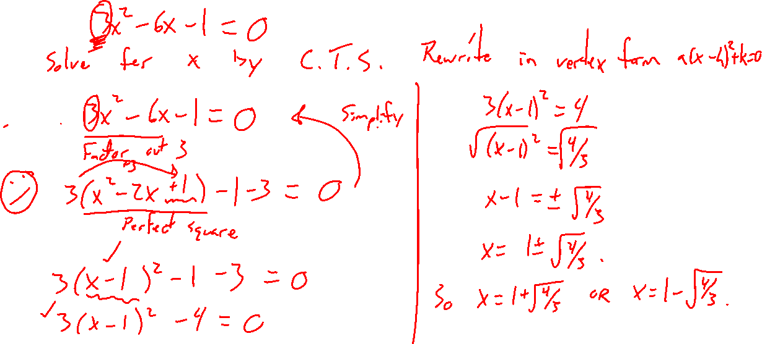
Example: Less Basic
Notes:
3x^2-6x-1=0

Slide 5
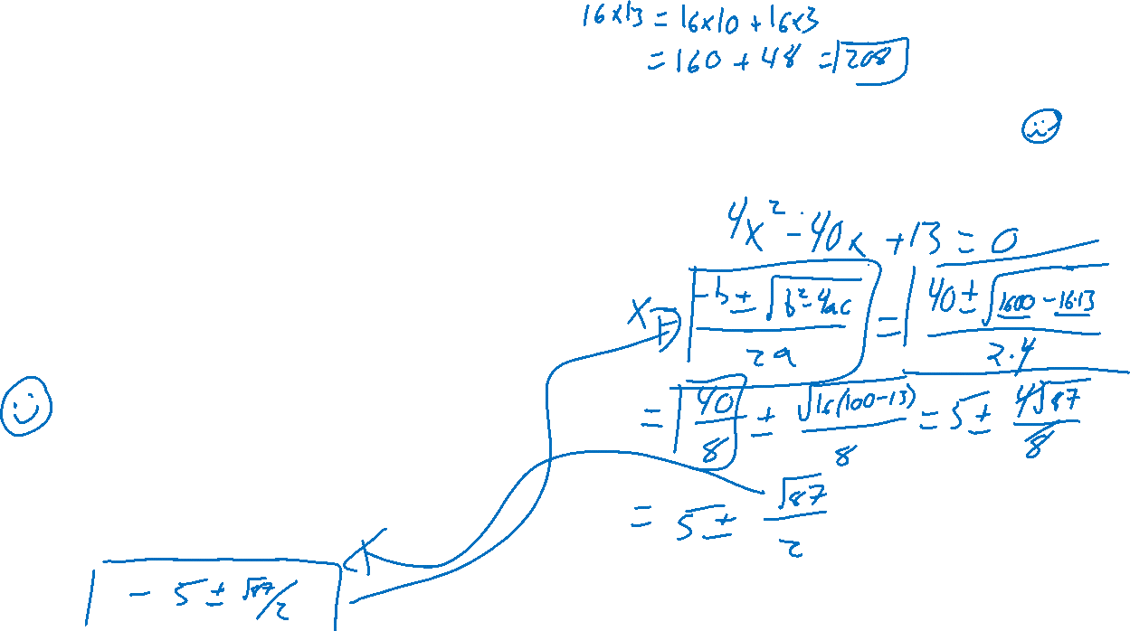
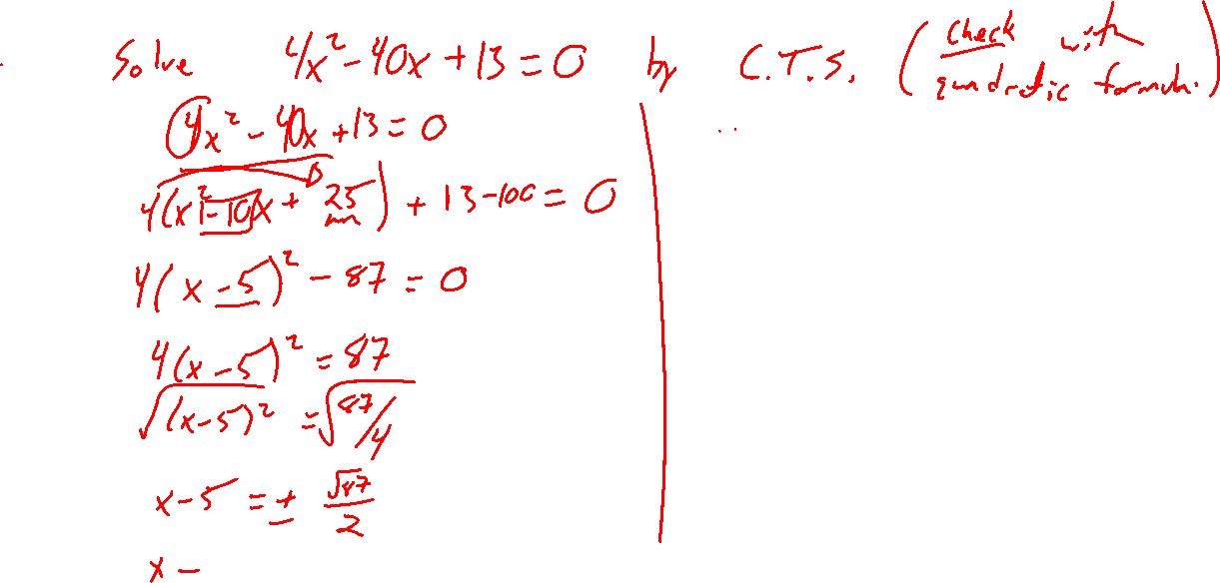
Example: Try on Own
Notes:
4x^2-40x+13=0
Check via quadratic formula, doesn’t factor easily
Note how similar to quadratic formula

Slide 6
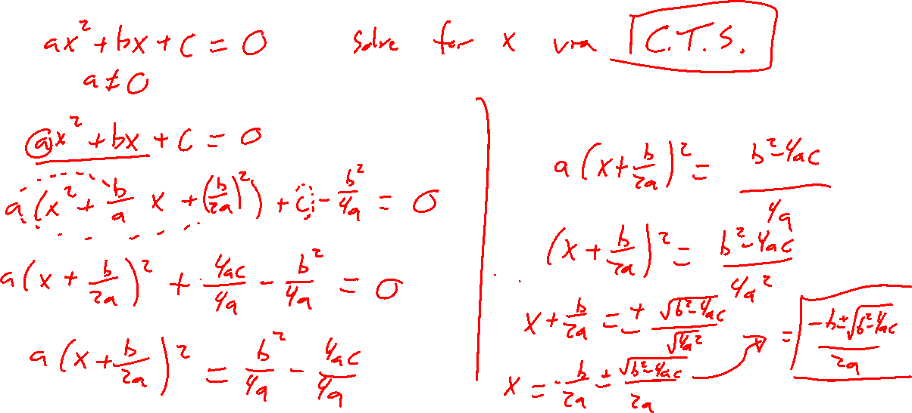
Quadratic Formula Derived
Notes:
Ax^2+bx+c=0
Complete the square in general
Check on previous example
Wiki page

Slide 7
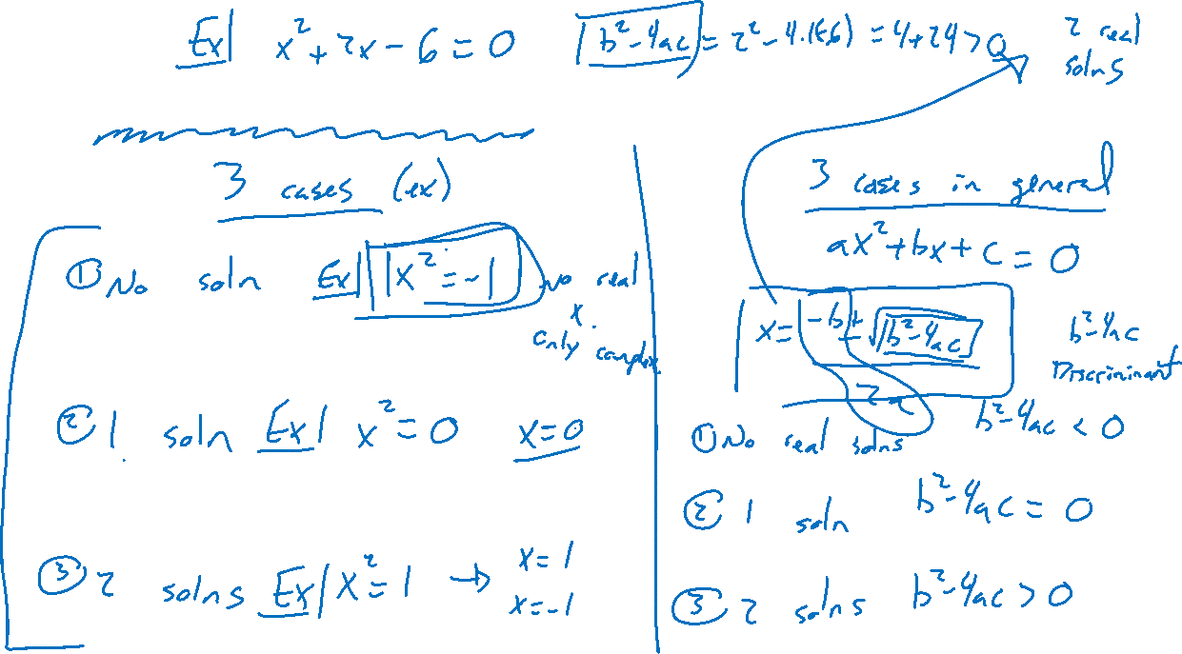
Number of Solutions to Quadratic Equations
Notes:
Do we always have 2 solutions? No: x^2=1,-1,0
Quadratic formula discrimant tells
Random example

Slide 8

Section 1.4: Textbook Examples and Exercises
Rework examples 1, 2, 3, 4, 5, 7 in the text. Steps:
Write down a problem.
Close the book and attempt on own.
Check / correct your solution against the text solution.
If needed, rewrite the problem to be of the quality of the text solution.
Complete exercises 5, 13, 19, 25, 35, 75
Write solutions of the same quality as in lecture and text solutions.
Check your solution against the answer in the back of the book.

Slide 9

Section 1.4 Homework Submission to Canvas
Preview of section
Skim the section in text and write a short paragraph summary.
Give a bulleted list of all important definitions, theorems, and formulas without details.
Notes on video lectures
Take notes on everything written on slides including all details, worked examples, on-own activities, as well as your own thoughts and questions.
Try on-own activities first, then write down provided solution next to it for comparison.
Worked examples from the text
Write down the problem and attempt without looking at the solution.
Use the solution to write the best explanation you can.
Solutions to textbook exercises
Model approaches and explanations given in the video lectures and textbook examples.
Final reflection of section
List the key takeaways to remember as a bulleted list.

